Slide 2
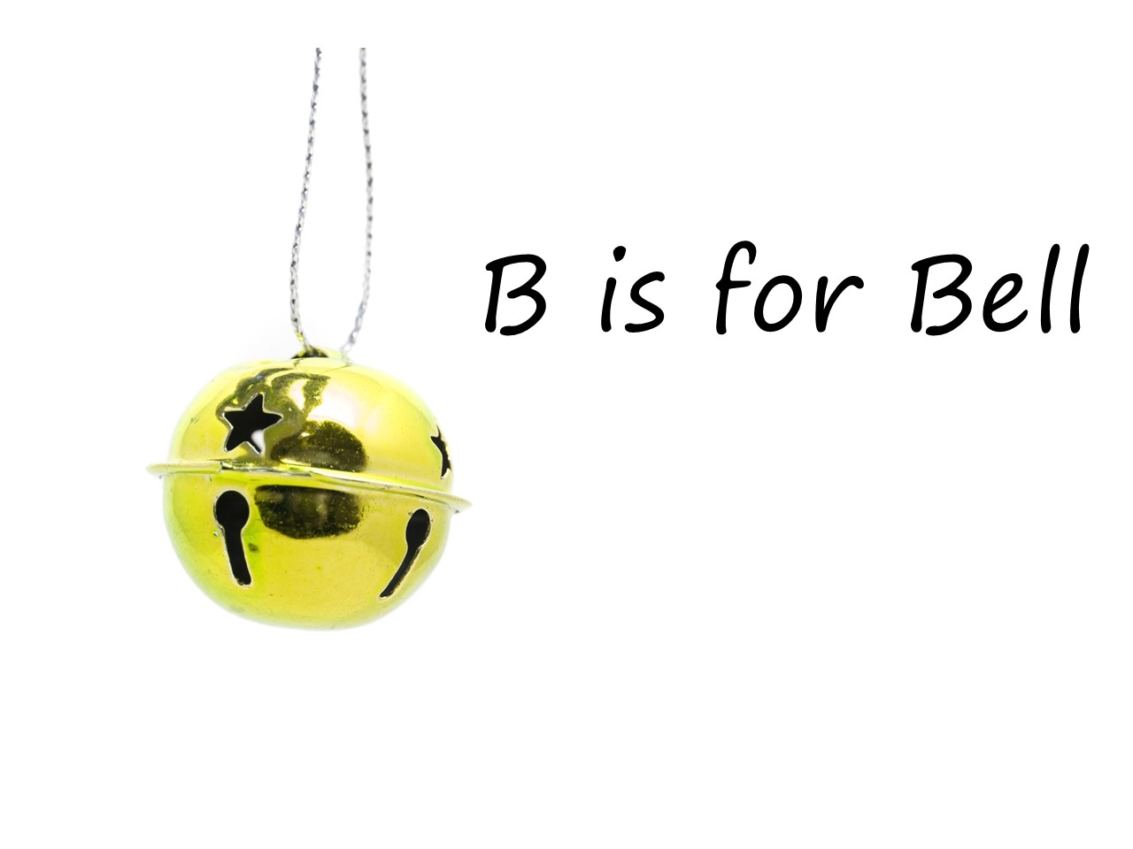

Slide 3
Throw = D

Slide 4
Throw = D Drop = G

Slide 5
Throw = D Drop = G Pick up = A

Slide 7
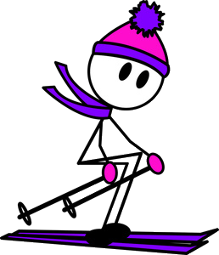
C
B BB

Slide 9
D
B
B
A A A

Slide 11
D D
C
A
G

